Slide 1


AWS Cloud Club at
Central University Of Jammu

Slide 2


What is Cloud Computing
Cloud computing is the on-demand delivery of IT resources like servers, storage, databases, networking, software, and analytics over the internet with pay-as-you-go pricing.
Instead of owning and maintaining physical infrastructure, users can access computing power and services from anywhere, at any time, and scale up or down as needed.

Slide 3
Benefits of Cloud Computing
  Cost reduction: No need to purchase hardware: you only pay for what you use.
  Scalability: Resources easily adjust to demand.
  Flexibility and accessibility: Access services and data from anywhere.
  Security: Built-in security tools and compliance with standards.
  Speed ​​and agility: Rapid deployment of applications and innovations.
  Automatic updates: Always up-to-date without manual intervention.

Slide 4
Introduction to AWS
AWS is a cloud computing platform, meaning it provides on-demand IT resources over the internet, allowing users to access technology services like computing power, storage, and databases allowing businesses to scale and manage their IT resources efficiently.

Slide 5

Why AWS?
AWS (Amazon Web Services) is the world’s most widely adopted cloud platform. It offers a broad set of services, flexible scalability, a global network of data centers, and strong security features. With AWS, businesses can quickly adapt to changing needs, innovate faster, and reduce costs thanks to its pay-as-you-go pricing model.

Slide 6
Companies Using AWS?
  Netflix – for global video streaming
  Airbnb – for hosting its platform
  Coca-Cola – for data analytics and IoT
  Samsung – for connected services
  NASA – for storing and processing space data
  BMW – for connected cars and smart manufacturing

Slide 7
Pay As You Go!!
AWS pay-as-you-go is a pricing model that allows users to pay only for the cloud resources they consume, similar to how utilities charge for usage. This flexible approach eliminates the need for long-term contracts, enabling businesses to scale their services according to demand. Types of Pay-As-You-Go Pricing Model
Charges are based on the actual usage of resources.
For example, AWS charges for storage in S3 based on the amount of data stored and the duration of storage.

Slide 8
Benefits of Pay-As-You-Go Pricing Model
  Lower Upfront Costs: Users only pay for what they use, making it attractive for businesses that may have fluctuating needs. For instance, a customer can send 5,000 emails one month and none the next without incurring costs.
  Scalability: The model allows for real-time adjustments in pricing based on usage, meaning higher consumption leads to higher charges without the need for renegotiating contracts.
  Faster Revenue Growth: Companies utilizing this model often experience higher year-over-year revenue growth compared to those with flat-rate pricing.

Slide 9
Categories of AWS Products
  Compute eg EC2, Lambda, ELB
  Storage eg EBS, S3
  Database eg RDS, DynamoDB, RedShift
  Networking & Content Delivery eg CDN, VPC, Direct Connect
  Machine Learning & Artificial Intelligence eg SageMaker, Rekognition, Polly
  Security, Identity & Compliance eg: IAM, KMS, etc.
ABOUT AWS CLUB >>

Slide 10

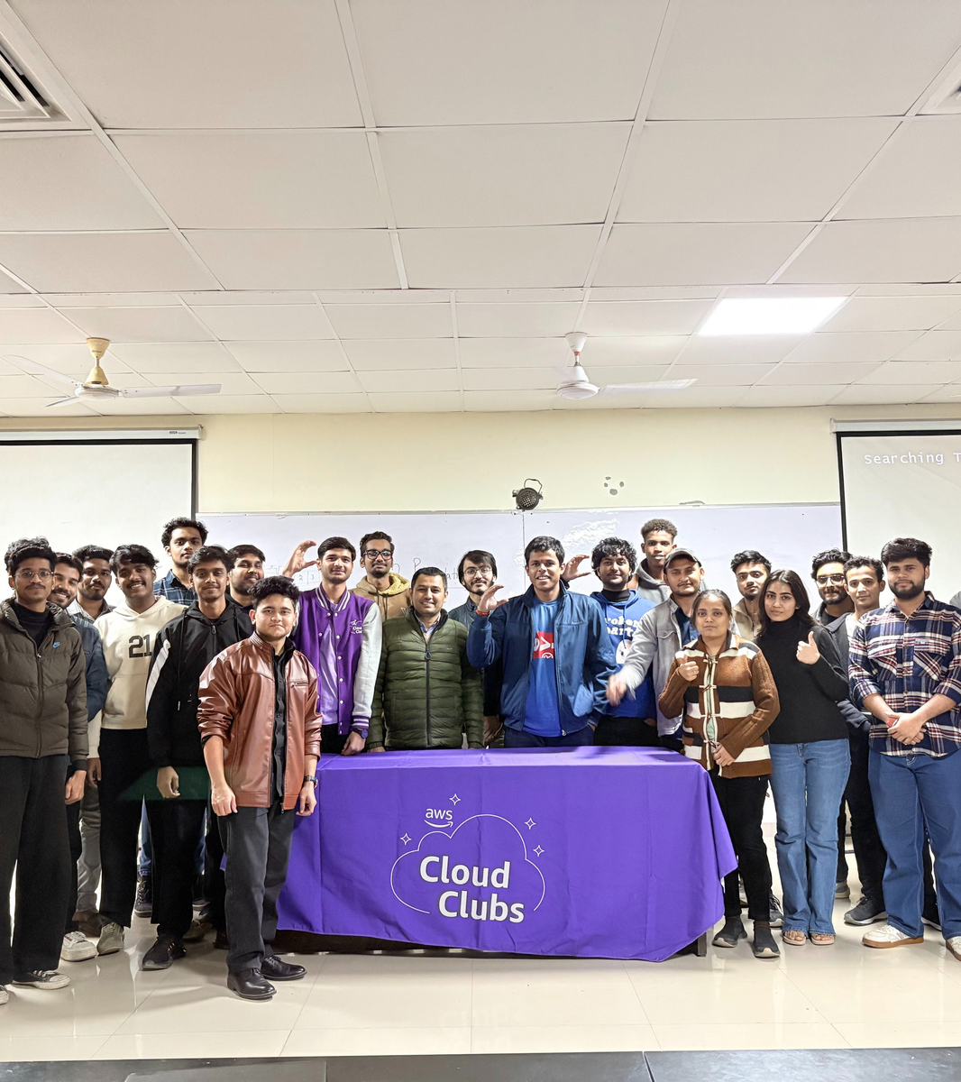
About AWS
Cloud Club
AWS Cloud Clubs are student-led, university-based communities supported by Amazon Web Services (AWS) for learners aged 18+ to explore cloud computing.
To provide a platform for students to connect, collaborate, and gain practical experience with AWS services.

Slide 11
AWS Compute services
Particularly Amazon EC2 (Elastic Compute Cloud) and AWS Lambda, are two of the most widely used offerings in the AWS ecosystem. They serve different purposes and are designed for different use cases.

Slide 12

Amazon EC2
(Elastic Compute Cloud)
Amazon EC2 provides resizable compute capacity in the cloud. It allows users to launch virtual servers (instances) on-demand, which can be configured with various operating systems, storage options, and networking capabilities.

Slide 13
EC2 Key Features:
  Instance Types: EC2 offers a variety of instance types optimized for different use cases, including compute-optimized, memory-optimized, storage-optimized, and GPU instances.
  Scalability: Users can scale their instances up or down based on demand. Auto Scaling can automatically adjust the number of instances in response to traffic.
  Control: Users have full control over the operating system, installed software, and configuration of the instances.

Slide 14
EC2 Use Cases:
  Hosting web applications and services.
  Running enterprise applications.
  Batch processing and data analysis.
  Development and testing environments.
Pricing:
  EC2 pricing is based on the instance type, region, and usage. Users can choose between On-Demand, Reserved, and Spot Instances to optimize costs.

Slide 15

AWS Lambda
  AWS Lambda is a serverless compute service that allows users to run code in response to events without provisioning or managing servers. Users only pay for the compute time consumed.

Slide 16
AWS Lambda
Key Features:
  Event-Driven: Lambda functions can be triggered by various AWS services (e.g., S3, DynamoDB, API Gateway) or external events (e.g., HTTP requests).
  Automatic Scaling: Lambda automatically scales the number of executions in response to incoming requests, handling thousands of requests simultaneously.
  No Server Management: Users do not need to manage the underlying infrastructure, allowing them to focus on writing code.

Slide 17
AWS Lambda
Key Features:
  Short-lived Execution: Lambda functions can run for a maximum of 15 minutes per invocation, making it suitable for short-lived tasks.
  Multiple Languages: Supports multiple programming languages, including Node.js, Python, Java, C#, Go, and Ruby.

Slide 18
AWS Lambda
Use Cases:
  Real-time file processing (e.g., image or video processing).
  Backend services for web and mobile applications.
  Automation of tasks and workflows.
Pricing:
  Lambda pricing is based on the number of requests and the duration of code execution (measured in milliseconds). There is a free tier that allows users to run a certain number of requests and compute time each month at no cost.

Slide 19
Comparison Summary

Slide 20
Comparison Summary
  Management: Users can manage the OS and server in EC2, while Lambda is fully managed with no server management required.
  Scaling: EC2 can be scaled manually or automatically; Lambda automatically scales based on events.
  Execution Duration: EC2 is suitable for long-running processes; Lambda is designed for short-lived tasks (up to 15 minutes).
  Use Cases: EC2 is ideal for general-purpose computing and web hosting; Lambda is best for event-driven applications and microservices.

Slide 21
Comparison Summary
  Pricing Model: EC2 charges for instance hours; Lambda charges for the number of requests and execution time.
  Control: EC2 provides full control over the environment; Lambda offers limited control, focused on code.
  Instance Types: EC2 offers various instance types; Lambda uses a serverless architecture with no instances.
  Persistent Storage: EC2 supports Amazon EBS for persistent storage; Lambda has no persistent storage (ephemeral).

Slide 22

Amazon Elastic File System (EFS)
Elastic File System (EFS) is a scalable, fully managed file storage service designed for use with AWS Cloud services and on-premises resources.
Key features include automatic scaling, high availability, and support for multiple EC2 instances accessing the same data concurrently, making it ideal for applications like content management, big data analytics, and web serving.

Slide 23
Amazon Elastic File System (EFS)
How many of you did understood my paragraph reading?

Slide 24
Amazon Elastic File System (EFS)
Example Scenario: Google Drive Analogy
Imagine this situation:
  You have a Google Drive account where you store all your important files, and your Google Drive is hosted on servers in the USA.
  Your friend, who lives in India, also has a Google Drive account. They upload files to their own Google Drive, which is hosted on servers in India.

Slide 25
Amazon Elastic File System (EFS)
The Scenario
  Sharing a Folder:
    Your friend in India wants to share a folder with you. They upload some important documents to their Google Drive and send you a link to that shared folder.
  Accessing the Folder:
    You click on the link your friend sent you, but instead of seeing the folder, you get an error message that says, "Sorry, this folder is not accessible" or "The folder is not available."

Slide 26
Amazon Elastic File System (EFS)
  How This Relates to Amazon EFS
    Centralized Access: Just like the shared Google Drive folder, Amazon EFS allows multiple users or applications to access the same files stored in one central location. If there’s an issue with EFS (like a server problem), users may not be able to access the files, similar to how you couldn’t access your friend’s folder.

Slide 27
Amazon Elastic File System (EFS)
  High Availability: EFS is designed to be highly available, meaning it stores data in multiple locations to prevent access issues. If one part of the EFS system has a problem, users can still access their files from another location, unlike the Google Drive example where a single server issue could block access.
  Permissions and Security: Just like with Google Drive, EFS has security features that control who can access the files. If permissions are not set correctly, users may not be able to access the data they need.

Slide 28

Amazon S3
Amazon S3 is a cloud-based object storage service provided by Amazon Web Services (AWS). It is designed to store and retrieve any amount of data from anywhere on the web. S3 is highly durable, scalable, and secure, making it a popular choice for businesses and developers looking to store data in the cloud.

Slide 29
Amazon S3 Key Features
  Scalability:
    S3 can handle virtually unlimited amounts of data, allowing users to scale their storage needs up or down as required without any upfront investment.
  Durability and Availability:
    Amazon S3 is designed for 99.999999999% (11 nines) durability, meaning your data is safe and protected against loss. It also offers high availability, ensuring that your data is accessible when you need it.

Slide 30
Amazon S3 Key Features
  Storage Classes:
    S3 Standard: For frequently accessed data.
    S3 Intelligent-Tiering: Automatically moves data between two access tiers when access patterns change.
    S3 Standard-IA (Infrequent Access): For data that is less frequently accessed but requires rapid access when needed.
    S3 Glacier: For long-term archival storage with retrieval times ranging from minutes to hours.

Slide 31
Amazon S3 Use Cases
  Backup and Restore:
    Organizations use S3 to back up critical data and applications, ensuring data durability and quick recovery in case of data loss.
  Content Distribution:
    S3 is commonly used to store and serve static website content, images, videos, and other media files. It can be integrated with Amazon CloudFront for fast content delivery.
  Data Archiving:
    Businesses use S3 Glacier for long-term data archiving, allowing them to store data at a lower cost while still being able to retrieve it when needed.

Slide 32
Amazon S3 Use Cases
  Big Data Analytics:
    S3 serves as a data lake for big data analytics, allowing organizations to store vast amounts of structured and unstructured data for analysis using services like Amazon Athena and Amazon Redshift.
  Application Hosting:
    Developers can host web applications and static websites directly from S3, making it a cost-effective solution for serving web content.

Slide 33
AWS Cloudfront
  Big Data Analytics:
    S3 serves as a data lake for big data analytics, allowing organizations to store vast amounts of structured and unstructured data for analysis using services like Amazon Athena and Amazon Redshift.
  Application Hosting:
    Developers can host web applications and static websites directly from S3, making it a cost-effective solution for serving web content.

Slide 34
AWS Cloudfront
  Big Data Analytics:
    S3 serves as a data lake for big data analytics, allowing organizations to store vast amounts of structured and unstructured data for analysis using services like Amazon Athena and Amazon Redshift.
  Application Hosting:
    Developers can host web applications and static websites directly from S3, making it a cost-effective solution for serving web content.

Slide 35




AWS Opportunities
AWS offers several educational programs and platforms to help students, developers, and future cloud professionals learn, practice, and certify their skills in cloud computing and emerging technologies.

Slide 36
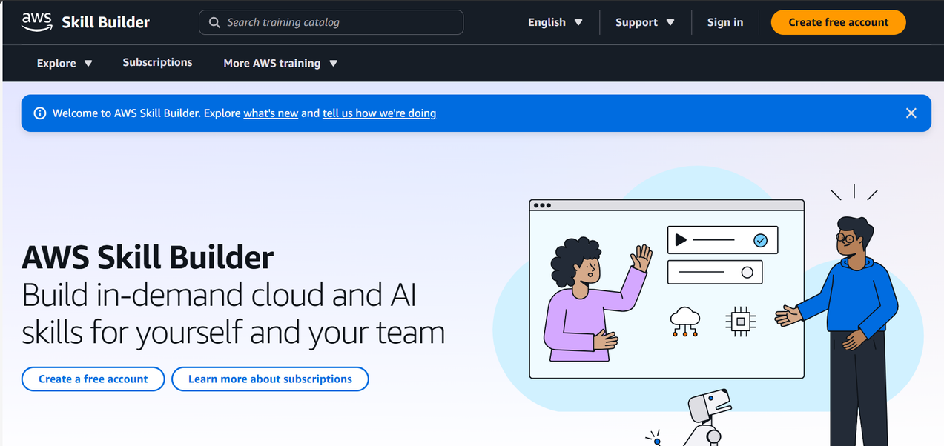
AWS Skill Builder
  A free online learning platform with hundreds of cloud training courses.
  Learn at your own pace: foundational to advanced topics.
  Includes hands-on labs, quizzes, and exam readiness paths.
  Opportunity to earn badges and prepare for AWS certifications.
📌 Perfect for beginners who want to explore cloud topics and start building skills.

Slide 37
AWS Cloud Quest
AWS Cloud Quest is an interactive, gamified learning experience.
  You play an avatar in a virtual city where you must solve real-world cloud challenges (e.g., deploy an app, secure a network).
  🧠 This fosters active, rather than theoretical, understanding.
  🎯 It's especially useful for those who learn by doing, not just reading.
  💥 Warning: Some users see it as just a game. But without real engagement, you can easily miss out on the deep learning potential.

Slide 38
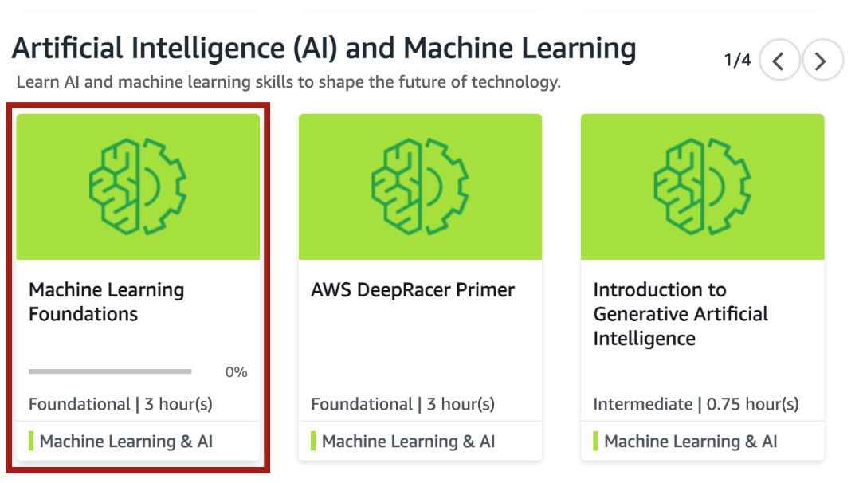
AWS Educate
  Designed specifically for students and educators.
  Offers free access to cloud learning content, labs, and even sandbox environments (no credit card needed).
  Allows you to explore career pathways like Cloud Support, Solutions Architect, and DevOps.
📌 Great entry point for students with little to no prior cloud experience.

Slide 39
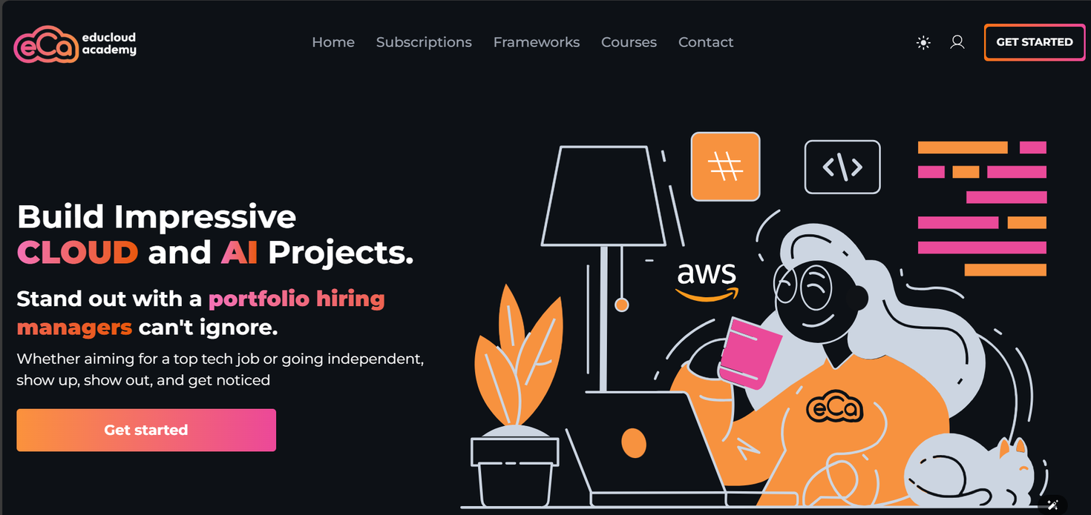
EduCloud Academy
Opportunity for Cameroonian students to become cloud-ready for local and international tech jobs.
Ideal for students in Cameroon looking for tailored cloud training with national support.

Slide 40


AWS Certification
  Foundational
    Knowledge-based certification for foundational understanding of AWS Cloud.

Slide 41


AWS Certification
  Professional
    Role-based certifications that validate advanced skills and knowledge required to design secure, optimized, and modernized applications and to automate processes on AWS.
  2 years of prior AWS Cloud experience recommended.

Slide 42
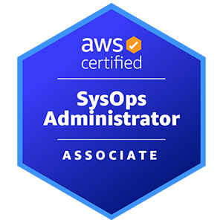




AWS Certification
  Associate
    Role-based certifications that showcase your knowledge and skills on AWS and build your credibility as an AWS Cloud professional. Prior cloud and/or strong on-premises IT experience recommended.

Slide 43

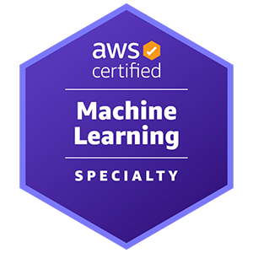

AWS Certification
  Specialty
    Dive deeper and position yourself as a trusted advisor to your stakeholders and/or customers in these strategic areas. Refer to the exam guides on the exam pages for recommended experience.

Slide 44

AWS Certification
  RESOURCE

Slide 45

FEEDBACK

